Slide 1
Natural Language Processing – Day 1
Text Mining

Slide 2
Agenda
Topics Covered: Day 1 (4 hours)
Text Mining (90 Minutes)
Introduction to text processing, analytics and mining
Text normalization, feature extraction, BOW, Similarity
Clustering and classification
Hands-on Session (150 Minutes)
Text pre-processing, BOW
K-Means clustering
Naïve Bayes classification
Prerequisites:
Java
Regex
Machine Learning
Evaluation metrics (Precision, Recall, ROC)
Topics Covered: Day 2 (4 hours)
Information Extraction (90 Minutes)
Typical NLP pipeline
Default entity extraction models
Custom entity extraction using Regex, POS, Dependency Relations
Hands-on Session (150 Minutes)
Setup
Default, Regex entity extraction
Custom entity extraction exercise
Prerequisites:
Java
Regex
Machine Learning
Evaluation metrics (Precision, Recall, ROC)

Slide 3
Text Mining - Definition
Data Mining: Discover new knowledge through analysis of data
Text Mining: Discover new knowledge through analysis of Text
Data
Unstructured Text
Methods
Statistical analysis
Pattern Recognition
Results
Patterns
Trends
Typically Large
Generally Noisy
Wide variety depending on domain, source
Machine Learning
Associations / Links

Slide 4
Notable Text Mining Applications
Text Mining
General Purpose
Government
Legal
Financial
Competitive intelligence
Healthcare & Life Sciences
Social Media
Publishing & Education
Drug research
Gene research
Plagiarism detection
Dictionary updates
Brand / Marketing
Electoral Trends
Patent Research
National Security / Intelligence
Info. Retrieval/Search
Info. Extraction
Sentiment analysis
E-Commerce
Sentiment Analysis
Summarization
Customer service
Spam filtering
Doc Classification
Opinion surveys
Claims Fraud detection
Cybercrime
Anti-terror
Fake news
Risk management
Clinical patient trends
Contextual Ads
Recommendations
Case history, summaries
Text data is everywhere – books, news, articles, financial analysis, blogs, social media, etc
According to estimates, 90% of world’s data is in “unstructured text format” (source: Oracle Corporation)
Need methods to extract, summarize, and analyze useful information from unstructured text
Automatically discover useful knowledge from the massive amount of data
Ongoing Active research

Slide 5
Text Mining Example: Obama vs McCain

Slide 6
Text Mining Challenges
Very high number of possible “dimensions”
All possible word and phrase types in the language!!
Unlike data mining
records (= docs) are not structurally identical
records are not statistically independent
highly redundant
Complex and subtle relationships between concepts in text
“AOL merges with Time-Warner”
“Time-Warner is bought by AOL”
Ambiguity and context sensitivity
automobile = car = vehicle = Toyota
Apple (the company) or apple (the fruit)
Easy for humans, hard for machine

Slide 7
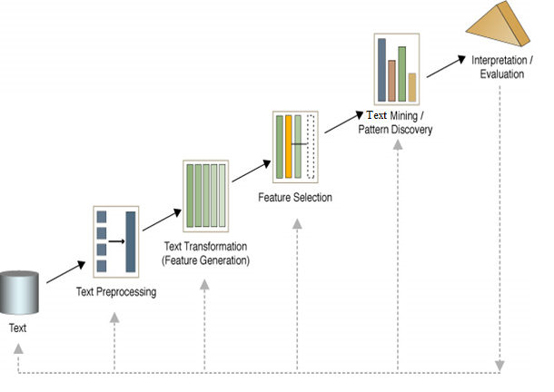
Text Mining Process
1. Text preprocessing
Lexical
Syntactical, occasionally semantic
2. Features Generation
Bag of words
3. Features Selection
Frequency, statistical based
Heuristic based
4. Text Mining
Clustering
Classification
5. Analyzing results
Mapping/Visualization
Result interpretation
Iterative and interactive process

Slide 8
1. Text Preprocessing

Slide 9
Text preprocessing – Lexical
The meaning of individual words.
Lexical analysis is the process of converting a stream of characters into a stream of words.
For instance, the following four particular cases have to be considered with care: digits, punctuation marks, and the case of the letters.
Numbers are usually not good index terms because, without a surrounding context, they are inherently vague.
The problem is that numbers by themselves are just too vague. Normally, punctuation marks are removed entirely in the process of lexical analysis.
The case of letters is usually not important for the identification of index terms. As a result, the lexical analyzer normally converts all the text to either lower or upper case

Slide 10
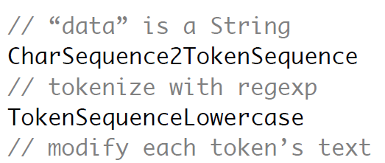
Text preprocessing – Lexical contd…
Some of the Lexical Analyzer Techniques:
Convert to lower case
Remove punctuation
Remove numbers
Lemmatization
Mallet:

Slide 11
Text preprocessing – Lexical - Lemmatization
-The lemmatizer returns, for a given word form (token) and Part of Speech tag, the dictionary form of a word, which is usually referred to as its lemma. A token could ambiguously be derived from several basic forms or dictionary words which is why the postag of the word is required to find the lemma.
Examples:
`show' may refer to either the verb "to show" or to the noun "show".
Rockwell NNP rockwell
International NNP international
Corp. NNP corp.
's POS 's
Tulsa NNP tulsa
unit NN unit
said VBD say
it PRP it
signed VBD sign

Slide 12
Text preprocessing – Lexical–Lemmatization contd…
OpenNLP
1. Pass Model File
LemmatizerModel model = null;
try (InputStream modelIn = new FileInputStream("en-lemmatizer.bin"))) {
model = new LemmatizerModel(modelIn);
}
2. Intantiate Lemmatizer
LemmatizerME lemmatizer = new LemmatizerME(model);
3. Pass Tokens and POS tags to lemmatize
String[] tokens = new String[]{"Most", "large", "cities", "in", "the", "US", "had",
"morning", "and", "afternoon", "newspapers", "."};
String[] tags = tagger.tag(sent);
String[] lemmas = lemmatizer.lemmatize(tokens, postags);

Slide 13
Text preprocessing – Syntactical
- It involves in maintaining the structure of statements/sentences.
Syntactic can be defined as to do with the arrangement of words and phrases when forming a sentence.
In linguistics, the syntactic rule is also considered as an important rule because in order to bring out the meaning the arrangement of the sentence has to be accurate.
Example 1:
The school goes to boy.
The boy goes to school.
Example 2:
Only John said he wants to write the first chapter.
John said he only wants to write the first chapter.

Slide 14
Text preprocessing – Semantics
Semantic - ‘to do with meaning’.
From this definition, it is clear that semantic emphasizes the significance of the meaning of words, phrases, etc.
Example:
You killed it.
1. This could simply denote that the individual has killed something, such as an animal.
2. But put the same sentence in the context of a musical performance. Here a person could say ‘you killed it’ to emphasize that the individual performed very well.

Slide 15
Text preprocessing – Semantics - POS Tagger
The Part of Speech Tagger marks tokens with their corresponding word type based on the token itself and the context of the token. A token might have multiple pos tags depending on the token and the context.
Example:
Pierre Vinken , 61 years old , will join the board as a nonexecutive director Nov. 29 . Mr. Vinken is chairman of Elsevier N.V. , the Dutch publishing group .
After POS tagging:
Pierre_NNP Vinken_NNP ,_, 61_CD years_NNS old_JJ ,_, will_MD join_VB the_DT board_NN as_IN a_DT nonexecutive_JJ director_NN Nov._NNP 29_CD ._. Mr._NNP Vinken_NNP is_VBZ chairman_NN of_IN Elsevier_NNP N.V._NNP ,_, the_DT Dutch_NNP publishing_VBG group_NN

Slide 16
Text preprocessing – Semantics - Chunking
Text chunking consists of dividing a text in syntactically correlated parts of words, like noun groups, verb groups, but does not specify their internal structure, nor their role in the main sentence.
Example:
The Chunker now reads a pos tagged sentence per line:
Rockwell_NNP International_NNP Corp._NNP 's_POS Tulsa_NNP unit_NN said_VBD it_PRP signed_VBD a_DT tentative_JJ agreement_NN extending_VBG its_PRP$ contract_NN with_IN Boeing_NNP Co._NNP to_TO provide_VB structural_JJ parts_NNS for_IN Boeing_NNP 's_POS 747_CD jetliners_NNS ._.
After Chunking:
[NP Rockwell_NNP International_NNP Corp._NNP ]
[NP 's_POS Tulsa_NNP unit_NN ]
[VP said_VBD ]
[NP it_PRP ]
[VP signed_VBD ] [NP a_DT tentative_JJ agreement_NN ] [VP extending_VBG ] [NP its_PRP$ contract_NN ] [PP with_IN ] [NP Boeing_NNP Co._NNP ] [VP to_TO provide_VB ] [NP structural_JJ parts_NNS ] [PP for_IN ] [NP Boeing_NNP ] [NP 's_POS 747_CD jetliners_NNS ] ._.

Slide 17
Text preprocessing – Text Normalization
Text normalization is the process of transforming text into a single canonical form
Text normalization is frequently used when converting text to speech. Numbers, dates, acronyms, and abbreviations are non-standard "words" that need to be pronounced differently depending on context.
Examples:
"$200" would be pronounced as "two hundred dollars" in English, but as "lua selau tālā" in Samoan.
Techniques:
1. Removing non-alphanumeric characters
2. Removing diacritical marks
3. Removing Multiple White spaces
Mallet:

Slide 18
Text preprocessing – Word Normalization
Stemming
Stemming is the process of reducing inflected (or sometimes derived) words to their word stem, base or root form.
Reduce dimensionality (number of features).
There are experiments that shows 5% of reduction from the document original size.

Slide 19
Text preprocessing – Unicode Normalization
Unicode sometimes assigns two different code points to entities that are essentially the same character.
Example :
The character "Å" can be encoded as U+00C5 (standard name "LATIN CAPITAL LETTER A WITH RING ABOVE", a letter of the alphabet in Swedish and several other languages
Å → U+212B ("ANGSTROM SIGN")

Slide 20
2. Feature Generation

Slide 21
Feature Generation - StopWords
Stopwords is a list of words that doesn't have the potential to contribute to characterize the content in the text.
They can reduce the size of texts by 30% to 50%.
Few stopwords are:
the, is, at, which, on, you…
Mallet:

Slide 22
Feature Generation - Document Collection
A collection of n documents can be represented in the vector space model by a term-document matrix.
An entry in the matrix corresponds to the “weight” of a term in the document; zero means the term has no significance in the document or it simply doesn’t exist in the document.
T₁ T₂ …. T_{t}
D₁ w₁₁ w₂₁ … w_{t1}
D₂ w₁₂ w₂₂ … w_{t2}
: : : :
: : : :
D_{n} w_{1n} w_{2n} … w_{tn}

Slide 23
Feature Generation - BOW
Bag of Words
Text document is represented by the words (features) it contains and their occurrences.
“Bag of words” Document Representation

Slide 24
Feature Generation – N-Grams
N- Grams
an n-gram is a contiguous sequence of n items from a given sequence of text or speech.
An n-gram of size 1 is referred to as a "unigram"; size 2 is a "bigram" (or, less commonly, a "digram"); size 3 is a "trigram". Larger sizes are sometimes referred to by the value of n in modern language, e.g., "four-gram", "five-gram", and so on.
Examples:
Sample Sequence: AGCTTCGA
Unigram: Mallet
A, G, C, T, T, C, G, A TokenSequenceNGrams(new int[] {1})
- By Default Unigrams
Bigram:
AG, GC, CT, TT, TC, CG, GA TokenSequenceNGrams(new int[] {2})
Trigram:
AGC, GCT, CTT, TTC, TCG, CGA TokenSequenceNGrams(new int[] {2})

Slide 25
Feature Generation contd…
Here are further examples; these are word-level 3-grams and 4-grams (and counts of the number of times they appeared) from the Google n-gram corpus.
3-grams
ceramics collectables collectibles (55)
ceramics collectables fine (130)
ceramics collected by (52)
ceramics collectible pottery (50)
ceramics collectibles cooking (45)
4-grams
serve as the incoming (92)
serve as the incubator (99)
serve as the independent (794)
serve as the index (223)
serve as the indication (72)
serve as the indicator (120)

Slide 26
Feature Generation – Frequency of tokens
In “Bag of words”representation each word is represented as a separate variable having numeric weight.
The most popular weighting schema is normalized word frequency tfidf:
tf(w)–term frequency (number of word occurrences in a document)
df(w)–document frequency (number of documents containing the word)
N–number of all documents
tfidf(w)–relative importance of the word in the document)
tfidf(w) = tf.log ( N / df ( W))
tf- The word is more important if it appears several times in a target document
df-word is more important if it appears in less documents

Slide 27
3. Feature Selection

Slide 28
Feature Selection
Machine learning works on a simple rule – if you put garbage in, you will only get garbage to come out. By garbage here, I mean noise in data.
Top reasons to use feature selection are:
It enables the machine learning algorithm to train faster.
It reduces the complexity of a model and makes it easier to interpret.
It improves the accuracy of a model if the right subset is chosen.
It reduces overfitting.

Slide 29
Feature Selection - Similarity Measures
A similarity measure is a function that computes the degree of similarity between two vectors.
Similarity Metrics:
Edit Distance Based
Token Based
-- Cosine Similarity
-- Jaccard Similarity
3. Wordnet Similarity measures

Slide 30
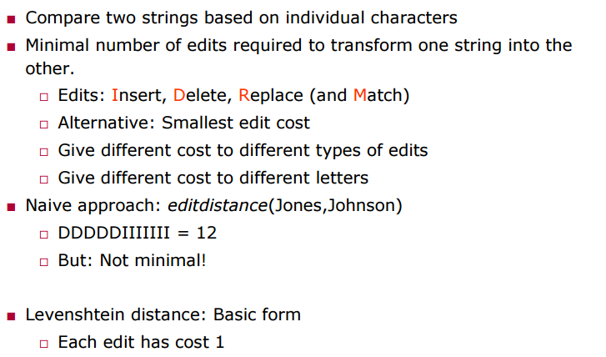
Edit Distance Based
Source: https://hpi.de/fileadmin/user_upload/fachgebiete/naumann/folien/SS13/DPDC/DPDC_12_Similarity.pdf

Slide 31
Token Based- Jaccard Similarity
The Jaccard index is defined as the size of the intersection of the two documents divided by the size of the union of the two documents.
Of course, we need to decide how to represent the two documents as sets. Of the different ways this can be done, we might:
Use a Bag Of Words, which is the list of unique words in the document, with no frequency count.
A Bag of Words with Stop Words removed (common language words like “the”, “at” for English).
Sets that take into account the frequency of words in the document.
k-Shingles which are fixed k length overlapping runs of characters
n-grams which are fixed length n word runs

Slide 32
Token Based - Cosine Similarity
Cosine similarity measures the cosine of the angle between two vectors.
Inner product normalized by the vector lengths.
t₃
CosSim(d_{j}, q) =
θ₁
D₁
Q
θ₂
t₁
t₂
D₂

Slide 33
Naïve Implementation
Convert all documents in collection D to tf-idf weighted vectors, d_{j}, for keyword vocabulary V.
Convert query to a tf-idf-weighted vector q.
For each d_{j} in D do
Compute score s_{j} = cosSim(d_{j,} q)
Sort documents by decreasing score.
Present top ranked documents to the user.
Time complexity: O(|V|·|D|) Bad for large V & D !
|V| = 10,000; |D| = 100,000; |V|·|D| = 1,000,000,000

Slide 34
Wordnet Similarity Measures
>>> dog = wn.synset('dog.n.01') >>> hit = wn.synset('hit.v.01')
>>> cat = wn.synset('cat.n.01') >>> slap = wn.synset('slap.v.01')
synset1.path_similarity(synset2):
Path Similarity: Return a score denoting how similar two word senses are, based on the shortest path that connects the senses in the is-a (hypernym/hypnoym) taxonomy.
>>> dog.path_similarity(cat) # doctest: +ELLIPSIS
0.2...
>>> hit.path_similarity(slap) # doctest: +ELLIPSIS
0.142...
>>> wn.path_similarity(hit, slap) # doctest: +ELLIPSIS
0.142...
Source : http://www.nltk.org/howto/wordnet.html

Slide 35
Wordnet Similarity Measures Cont…
synset1.lch_similarity(synset2):
Leacock-Chodorow Similarity: Return a score denoting how similar two word senses are, based on the shortest path that connects the senses (as above) and the maximum depth of the taxonomy in which the senses occur.
>>> dog.lch_similarity(cat) # doctest: +ELLIPSIS
2.028...
>>> hit.lch_similarity(slap) # doctest: +ELLIPSIS
1.312...
>>> wn.lch_similarity(hit, slap) # doctest: +ELLIPSIS
1.312...
>>> print(hit.lch_similarity(slap, simulate_root=False))
None
>>> print(wn.lch_similarity(hit, slap, simulate_root=False))
None
Source : http://www.nltk.org/howto/wordnet.html

Slide 36
Wordnet Similarity Measures Cont…
synset1.wup_similarity(synset2):
Wu-Palmer Similarity: Return a score denoting how similar two word senses are, based on the depth of the two senses in the taxonomy and that of their Least Common Subsumer (most specific ancestor node).
>>> dog.wup_similarity(cat) # doctest: +ELLIPSIS
0.857...
>>> hit.wup_similarity(slap)
0.25
>>> wn.wup_similarity(hit, slap)
0.25
>>> print(hit.wup_similarity(slap, simulate_root=False))
None
>>> print(wn.wup_similarity(hit, slap, simulate_root=False))
None
Source : http://www.nltk.org/howto/wordnet.html

Slide 37
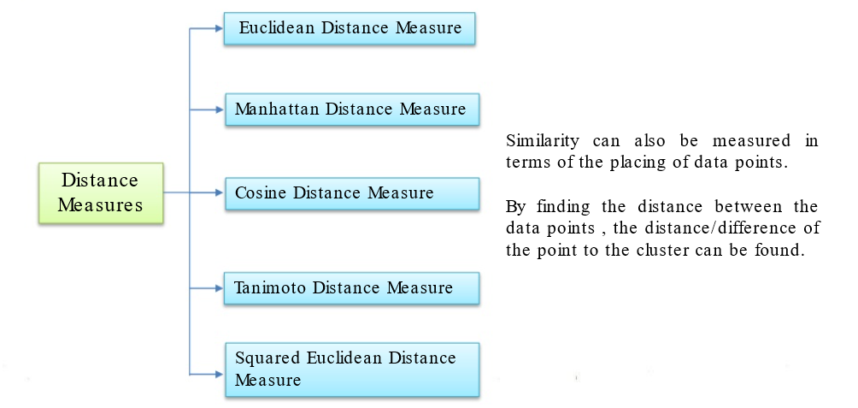
Dissimilarity Measurements (Distance Measures)

Slide 38
4. Classification

Slide 39
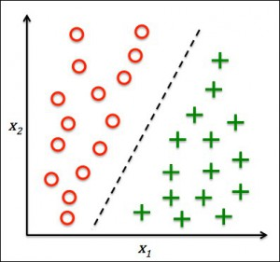
What is Classification ?
Classification is the problem of identifying to which of a set of categories (sub-populations) a new observation belongs, on the basis of a training set of data containing observations (or instances) whose category membership is known.

Slide 40
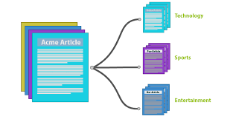
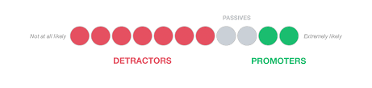

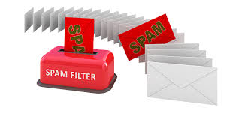
Examples
In Marketing
New article classification
Insurance Companies
Spam filtering
Notes:
Marketing : As marketing is becoming more targeted everyday, automated classification of users into cohorts can make marketer’s life simple. Marketers can monitor and classify users based on how they talk about a product or brand online. The classifier can be trained to identify promoters or detractors. Thus, making brands to serve the cohorts better
Insurance companies collect huge volumes of text on a daily basis The information collected includes policies, expert and health reports, claims and complaints, results of surveys, relevant interactions between customers and no-customers in social networks
The number of news articles published on various websites in general and news websites in particular had a dramatic increase over the last years. Nowadays both journalists and media monitoring companies face the problem of mastering large amounts of articles in order to identify important topics and events all around the world
Being increadibly cheap to send, spam causes a lot of trouble to the Internet community: large amounts of spam-traffic between servers cause delays in delivery of legitimate email, people with dial-up Internet access have to spend bandwidth downloading junk mail. Sorting out the unwanted messages takes time and introduces a risk of deleting normal mail by mistake

Slide 41
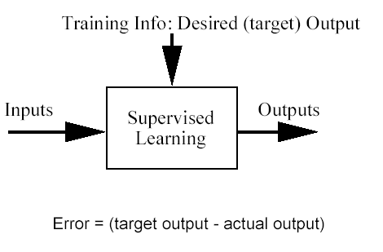
Classification problem
Training data: examples of the form (d,h(d))
where d are the data objects to classify (inputs)
and h(d) are the correct class info for d, h(d){1,…K}
Goal: given d_{new}, provide h(d_{new})

Slide 42
Different types of Classifiers
1. Generative:
- A generative model is a model for randomly generating observable data values, typically given some hidden parameters
- generative model is a full probabilistic model
- e.g., Naive Bayes, Hidden Markov Models
2. Discriminative
- directly estimate a decision rule/boundary
- e.g., linear regression, logistic regression, SVM,K-nearest neighbor
Source:Wikipedia

Slide 43
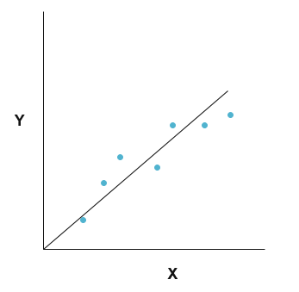
Linear regression
Given an input x we would like to compute an output y
For example:
- Predict height from age
- Predict Google’s price from Yahoo’s price
- Predict distance from wall from sensors
Source:Wikipedia

Slide 44
Linear regression contd…
Our goal is to estimate w from a training data of <xi,yi> pairs
Optimization goal: minimize squared error (least squares):
Why least squares?
- minimizes squared distance between measurements and predicted line
- has a nice probabilistic interpretation
- the math is pretty
Y
X
Source:Wikipedia

Slide 45

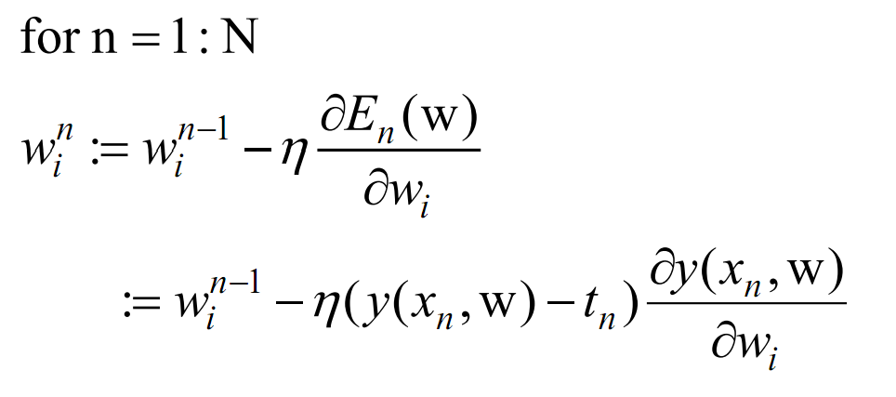
Gradient descent
Source: ayearofai.com

Slide 46
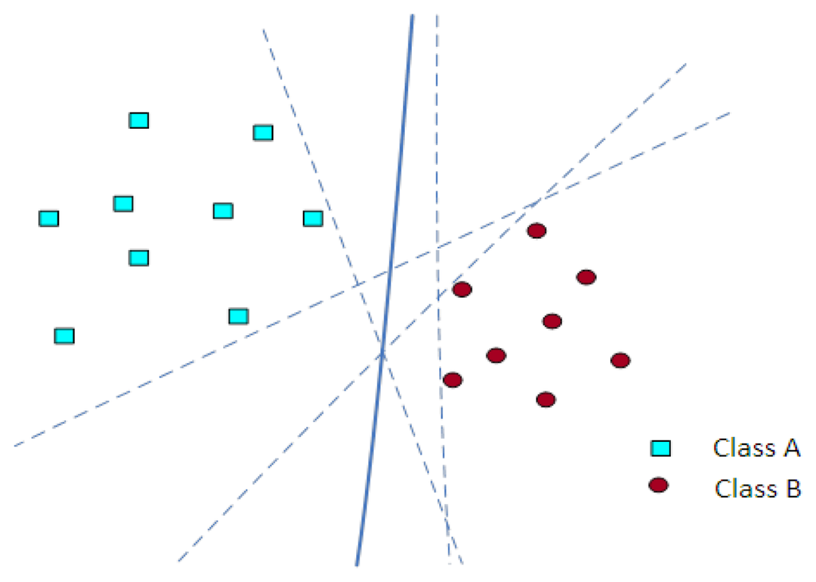
Support Vector Machine(SVM)
Support vector machines are computational algorithms that construct a hyperplane or a set of hyperplanes in a high or infinite dimensional space to classify data.
It is a supervised machine learning algorithm
ImageSource:MDPI
Source:AnalyticsVidhya

Slide 47
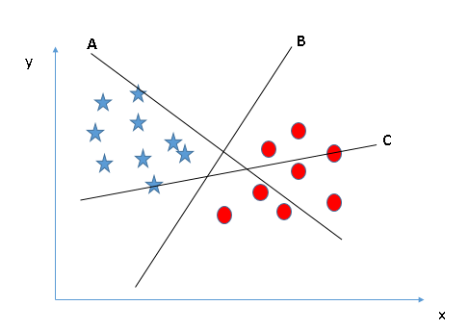
Support Vector Machine (contd…)
SVM is an approach where the objective is to find the best separation hyperplane, that is, the hyperplane that provides the highest margin distance between the nearest points of the two classes (called functional margin).
We have three hyper-planes (A, B and C). Now, identify the right hyper-plane to classify star and circle.
The hyper-plane B segregates the two classes better
Source:AnalyticsVidhya

Slide 48

Support Vector Machine (contd…)
SVMs maximize the margin around the separating hyperplane.
A.k.a. large margin classifiers
The decision function is fully specified by a subset of training samples, the support vectors.
Solving SVMs is a quadratic programming problem
Seen by many as the most successful current text
classification method.
Source:AnalyticsVidhya

Slide 49
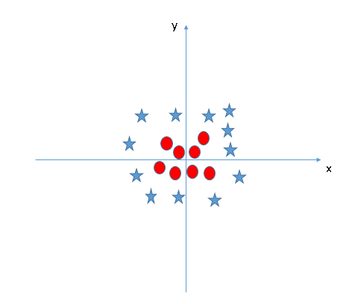
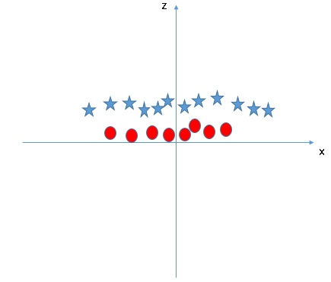
Non- Linear SVM
ImageSource:AnalyticsVidhya

Slide 50
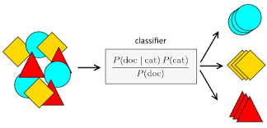
Naïve Bayes
Naive Bayes model is easy to build and particularly useful for very large data sets.
It is a classification technique based on Bayes’ Theorem with an assumption of independence among predictors.
In simple terms, a Naive Bayes classifier assumes that the presence of a particular feature in a class is unrelated to the presence of any other feature that is why it is known as ‘Naive’.
Source:AnalyticsVidhya

Slide 51
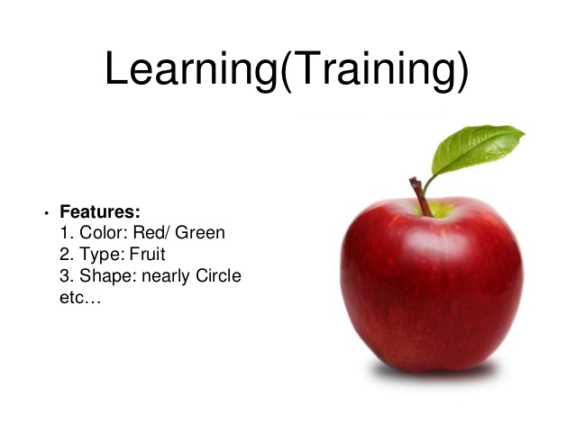
Naïve Bayes contd…
For example, a fruit may be considered to be an apple if it is red, round, and about 3 inches in diameter. Even if these features depend on each other or upon the existence of the other features, all of these properties independently contribute to the probability that this fruit is an apple
Mallet:
Training:
ClassifierTrainer trainer = new NaiveBayesTrainer();
Classifier classifier = trainer.train(instances);
Testing:
Labeling labeling = classifier.classify(instance);
Label l = labeling.getBestLabel();
System.out.print(instance + “\t”);
System.out.println(l);
Source:AnalyticsVidhya

Slide 52
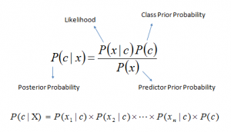
Bayes Theorem
P(c|x) is the posterior probability of class (c, target) given predictor (x, attributes).
P(c) is the prior probability of class.
P(x|c) is the likelihood which is the probability of predictor given class.
P(x) is the prior probability of predictor.
Source:AnalyticsVidhya

Slide 53
Probabilistic Classification
Establishing a probabilistic model for classification
To train a discriminative classifier regardless its probabilistic or non-probabilistic nature, all training examples of different classes must be jointly used to build up a single discriminative classifier.
Output L probabilities for L class labels in a probabilistic classifier.
Probabilistic Classifier
Source:SlideShare

Slide 54
Maximum A Posterior (MAP) Classification
Maximum A Posterior (MAP) classification rule
For an input x, find the largest one from L probabilities output by a discriminative probabilistic classifier
Assign x to label c* if is the largest.
Generative classification with the MAP rule
Apply Bayesian rule to convert them into posterior probabilities
- Then apply the MAP rule to assign a label
Common factor for all L probabilities
Source:SlideShare

Slide 55
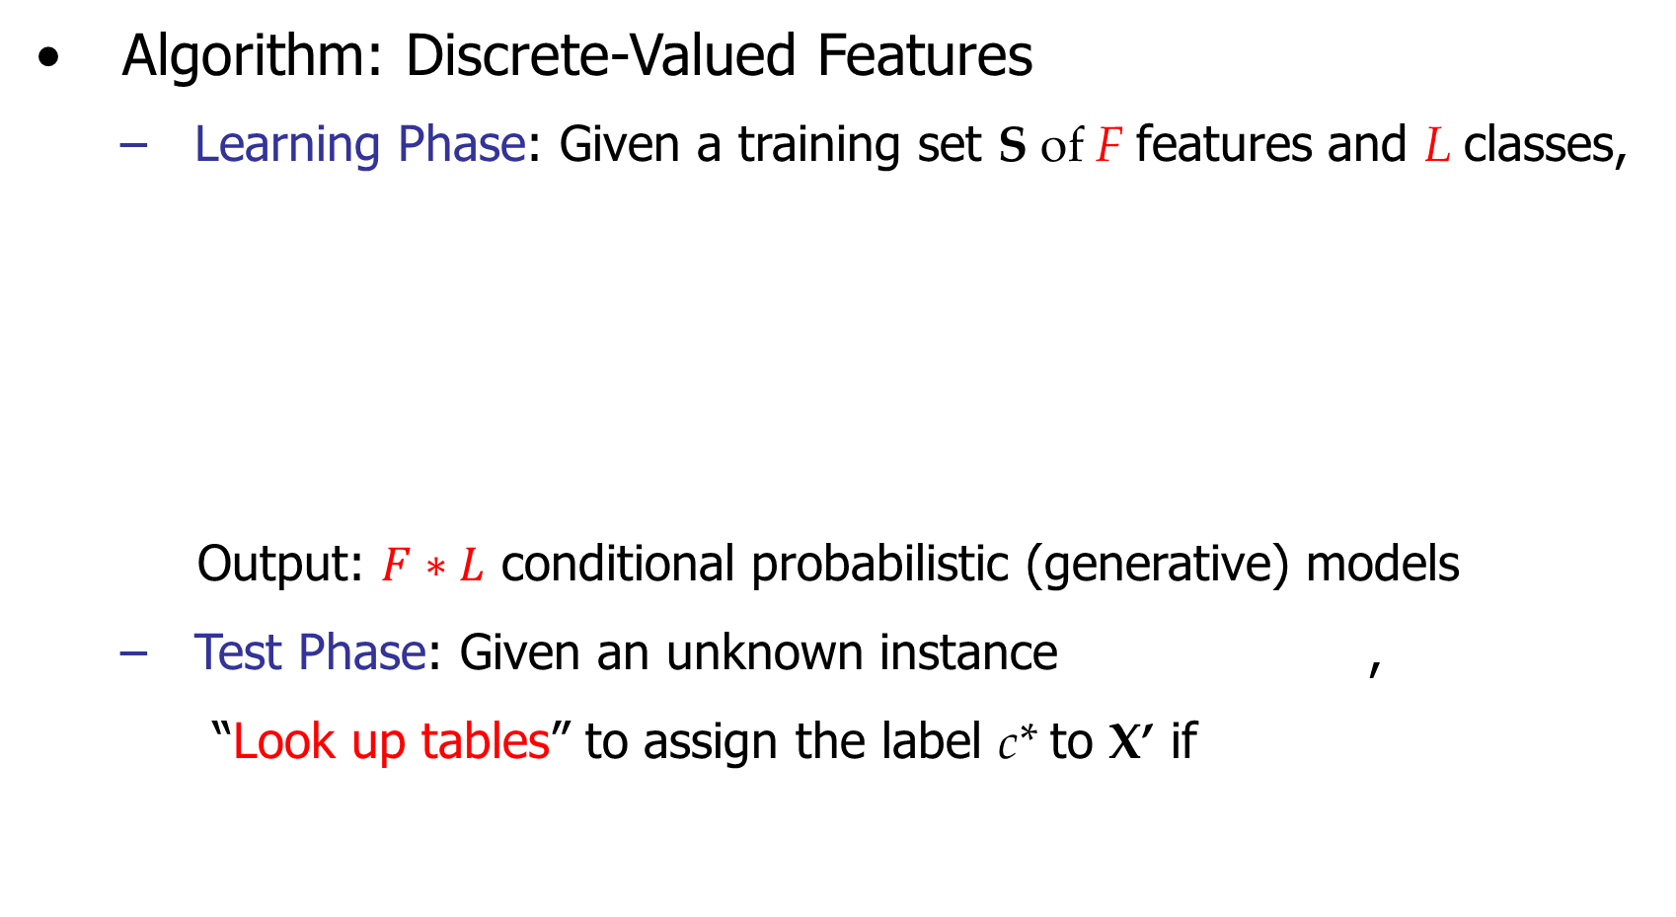
Naïve Bayes
Source:SlideShare

Slide 56
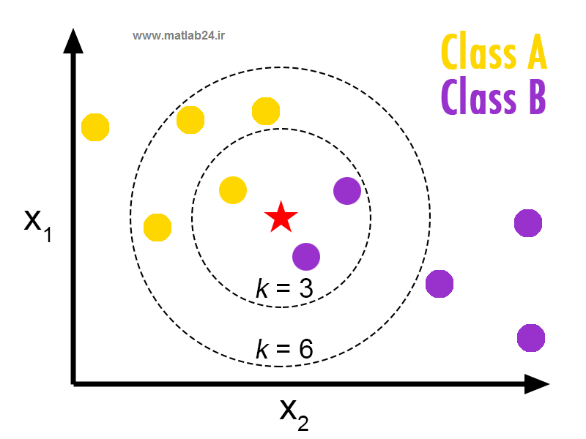
K-Nearest Neighbor Classifier
In k-NN classification, the output is a class membership. An object is classified by a majority vote of its neighbors
ImageSource : http://en.proft.me
Source:Wikipedia

Slide 57
5. Clustering

Slide 58
What is clustering?
Finding groups of objects such that the objects in a group will be similar (or related) to one another and different from (or unrelated to) the objects in other groups.
Discover new categories in an unsupervised manner (no sample category labels provided).
Motivation
-- Automatically group related documents based on their contents
-- No predetermined training sets or taxonomies
-- Generate a taxonomy at runtime
Source:Wikipedia
Inter-cluster distances are maximized
Intra-cluster distances are minimized

Slide 59
Document Clustering Applications
Finding Similar Documents
Organizing Large Document Collections
Duplicate Content Detection
Recommendation System
Search Optimization
Source:http://cse.iitkgp.ac.in/~abhij/facad/03UG/Report/03CS3024_Pankaj_Jajoo.pdf
Notes:
Finding Similar Documents This feature is often used when the user has spotted one “good” document in a search result and wants more-like-this. The interesting property here is that clustering is able to discover documents that are conceptually alike in contrast to search-based approaches that are only able to discover whether the documents share many of the same words.
• Organizing Large Document Collections Document retrieval focuses on finding documents relevant to a particular query, but it fails to solve the problem of making sense of a large number of uncategorized documents. The challenge here is to organize these documents in a taxonomy identical to the one humans would create given enough time and use it as a browsing interface to the original collection of documents.
• Duplicate Content Detection In many applications there is a need to find duplicates or near-duplicates in a large number of documents. Clustering is employed for plagiarism detection, grouping of related news stories and to reorder search results rankings (to assure higher diversity among the topmost documents). Note that in such applications the description of clusters is rarely needed.
• Recommendation System In this application a user is recommended articles based on the articles the user has already read. Clustering of the articles makes it possible in real time and improves the quality a lot.
• Search Optimization Clustering helps a lot in improving the quality and efficiency of search engines as the user query can be first compared to the clusters instead of comparing it directly to the documents and the search results can also be arranged easily.

Slide 60
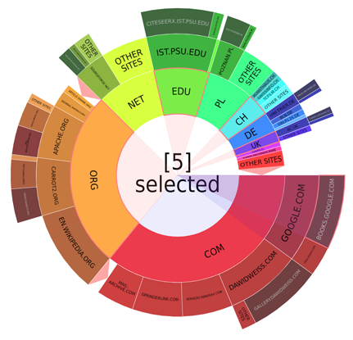
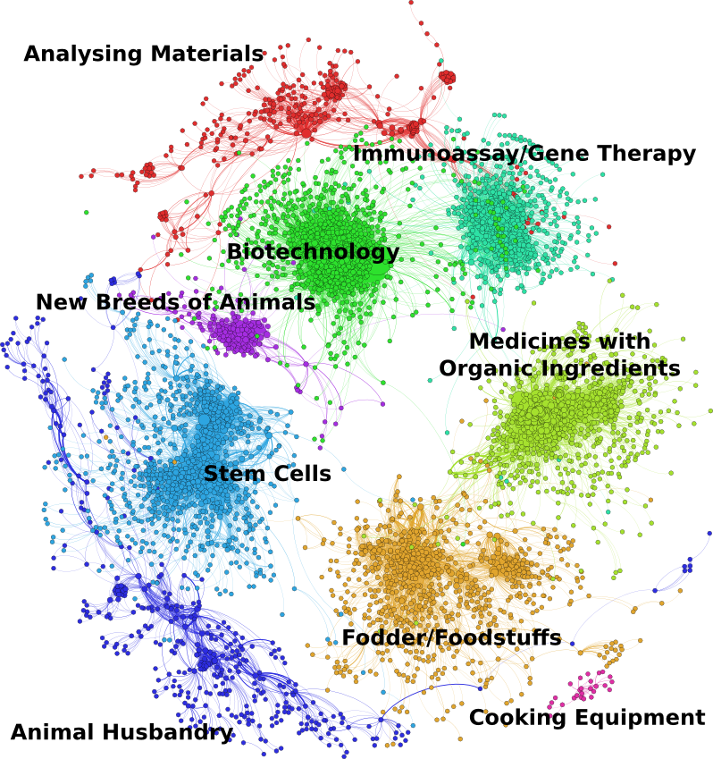
Document Clustering Examples
Clustering news articles based on topics
Clustering movie reviews as positive or negative
Clustering e-mails as spam or otherwise
Web search results sorted by category
Magazine articles sorted based on university disciplines
Tweets during elections clustered candidate wise
Image Source : https://project.carrot2.org/release-3.2.0-notes.html

Slide 61
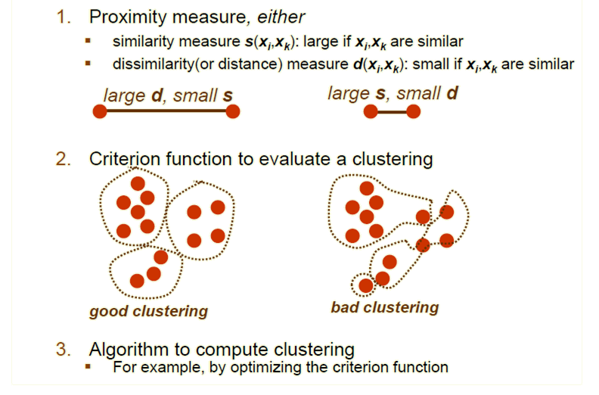
What do we need for clustering?

Slide 62
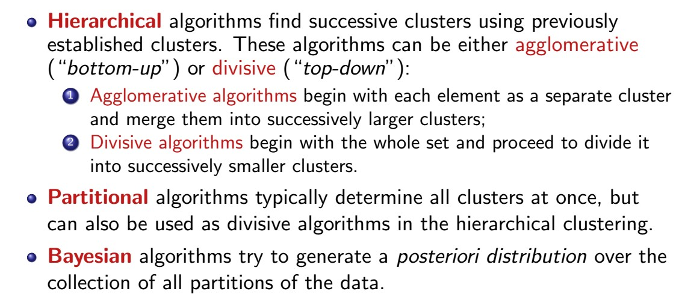
Clustering Techniques

Slide 63
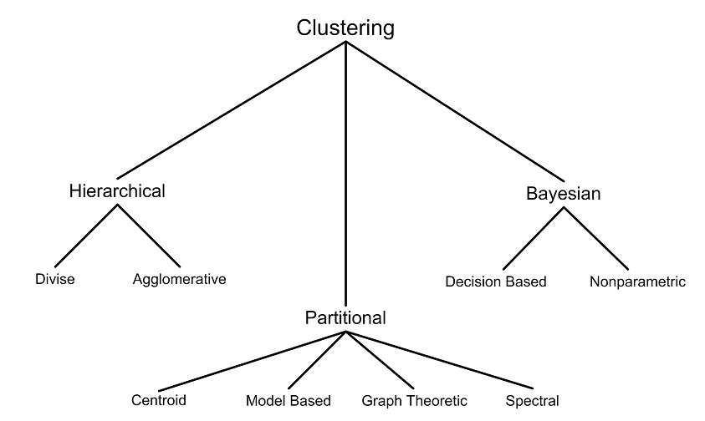

Clustering Techniques contd…
K
-
means

Slide 64
K-Means Algorithm
Partitions a collection of vectors {x₁, x₂, . . . x_{n}} into a set of clusters {C₁, C₂, . . . C_{k}}.
The algorithm needs k cluster seeds for initialization. The algorithm proceeds as follows:
Initialization:
k seeds, either given or selected randomly, form the core of k clusters.
Every other vector is assigned to the cluster of the closest seed.
Iteration:
The centroids M_{i} of the current clusters are computed:
Each vector is reassigned to the cluster with the closest centroid.
Stopping condition:
At convergence – when no more changes occur.
The K-means algorithm maximizes the clustering quality function Q:

Slide 65
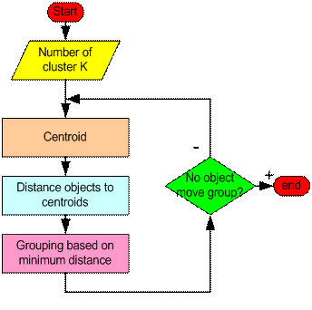
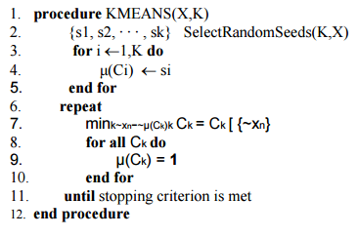
How the K-Mean Clustering algorithm works?
Image source : http://people.revoledu.com/kardi/tutorial/kMean/NumericalExample.htm

Slide 66
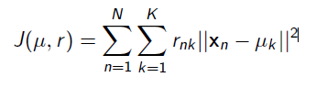
K-means: The Objective Function
Let μ₁, . . . , μ_{K} be the K cluster centroids (means)
Let r_{nk} ε {0, 1} be indicator denoting whether point x_{n} belongs to cluster k
K-means objective minimizes the total distortion (sum of distances of points
from their cluster centers)

Slide 67
K-means: Choosing the number of clusters K
One way to select K for the K-means algorithm is to try different values of K, plot the K-means objective versus K, and look at the “elbow-point” in the plot
For the below plot, K = 2 is the elbow point

Slide 68
K-Means Clustering example
Pick K random points in the 2D space as centers (means) for the clusters (synaptic weights) to be created
Shown here for K=2

Slide 69
K-Means Clustering example contd…
Iterative Step 1
Assign data points to closest cluster center
We take up data points from the space and find out its distance from both clusters centers
If the data point is closest to the red cluster center, it is colored red.

Slide 70
K-Means Clustering example contd…
Iterative Step 2
• Change the cluster
center to the average of the assigned points (adjust synaptic weights)

Slide 71
K-Means Clustering example contd…
Step 1 and step 2 are run iteratively unless the cluster centers converge at a point and no longer move.

Slide 72
K-Means Clustering example contd…
Cluster centers still not converged, so we go ahead and iterate even more

Slide 73
K-Means Clustering example contd…

Slide 74
K-Means Clustering example contd….
Finally after multiple iterations, we reach a stage where the cluster centers converge and look like this.

Slide 75
K-means: Initialization issues contd…
K-means is extremely sensitive to cluster center initialization.
Bad initialization can lead to:
- Poor convergence speed
- Bad overall clustering
Safeguarding measures:
- Choose first center as one of the examples, second which is the farthest from the first, third which is the farthest from both, and so on.
- Try multiple initializations and choose the best result
- Other smarter initialization schemes (e.g., look at the K-means++ algorithm by Arthur and Vassilvitskii)

Slide 76
K-means: Limitations
Makes hard assignments of points to clusters
A point either completely belongs to a cluster or not belongs at all
No notion of a soft assignment (i.e., probability of being assigned to each cluster: say K = 3 and for some point xn, p1 = 0.7, p2 = 0.2, p3 = 0.1)
Gaussian mixture models and Fuzzy K-means allow soft assignments
Sensitive to outlier examples (such examples can affect the mean by a lot)
K-medians algorithm is a more robust alternative for data with outliers
Reason: Median is more robust than mean in presence of outliers
Works well only for round shaped, and of roughtly equal sizes/density clusters
Does badly if the clusters have non-convex shapes
Spectral clustering or kernelized K-means can be an alternative
The algorithm is only applicable if the mean is defined.
The user needs to specify k.

Slide 77
K-means Limitations Illustrated
Non-convex/non-round-shaped clusters: Standard K-means fails!
Clusters with different densities
Image source : Text Clustering,Kanimozhiu,CEG, Anna University, Chennai

Slide 78
Outliers
Image source : Text Clustering,Kanimozhiu,CEG, Anna University, Chennai

Slide 79
Sensitivity to initial seeds
Image source : Text Clustering,Kanimozhiu,CEG, Anna University, Chennai

Slide 80
Why use K-means?
-- Simple: easy to understand and to implement
-- Efficient / low computational cost:
Time complexity: O(tkn), where n is the number of data points,
K is the number of clusters,
t is the number of iterations.
-- Faster : Since both k and t are small, k-means is considered a linear algorithm (because order of time complexity is linear with the number of data); faster than hierarchical clustering O(n²)
-- K-Means produce tighter clusters than hierarchical clustering, especially if the clusters are globular.
-- K-mean algorithm is good for large dataset

Slide 81
5. Evaluation

Slide 82

Evaluation – Confusion Matrix
Fmeasure
- the weighted harmonic mean of the precision and recall of the test
Recall
- The recall or true positive rate (TP) is the proportion of positive cases that were correctly identified, as calculated using the equation:
Precision
- precision (P) is the proportion of the predicted positive cases that were correct, as calculated using the equation

Slide 83
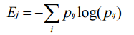
Evaluation - Entropy
Disorder of objects within the cluster.
For each cluster, the category distribution of data is calculated first i.e pij is the probability that a member of cluster j belongs to category i.
Then the entropy of each cluster j is calculated as the total entropy is calculated as the sum of the entropies of each cluster weighted by the size of each cluster

Slide 84
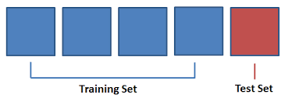
Evaluation - Entropy
K-fold cross-validation: The available data is partitioned into n equal-size disjoint subsets.
Use each subset as the test set and combine the rest n-1 subsets as the training set to learn a classifier.
The procedure is run n times, which give n accuracies.
The final estimated accuracy of learning is the average of the n accuracies.
10-fold and 5-fold cross-validations are commonly used.
This method is used when the available data is not large.

Slide 85
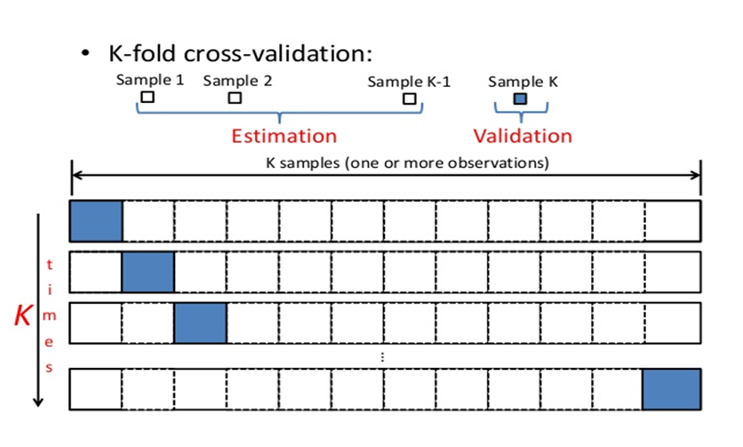
Cross-validation: How it works?

Slide 86
6. Mallet

Slide 87
Mallet
We have open-source API’s to do clustering, classification and extraction
JAVA API: Mallet
Authors: Andrew McCallum, Charles Sutton, Aron Culotta, Greg Druck, Kedar Bellare, Gaurav Chandalia, FernandoPereira
Main Objective o: Text Classification & Information Extraction

Slide 88
Interpretation - Mallet
Mallet:
Authors: Andrew McCallum, Charles Sutton, Aron Culotta, Greg Druck, Kedar Bellare, Gaurav Chandalia, FernandoPereira
How to use?
1. Command line scripts
2. Java API
Available Packages:
1. Document classification
2. Clustering
3. Topic Modeling
4. Information Extraction

Slide 89
Interpretation – Mallet – Data representation
Document Classification:
Algorithms in mallet for classification:
1. Supervised Learning Algorithms:
2. Naïve Bayes
3. Maximum entropy
4. Decision trees
Data representation
MALLET represents data as lists of "instances".
A MALLET Instance consists of four fields, which can be of any Object type.
1. Name: This field should contain a value that identifies this instance, usually a String.
2. Label: The label is primarily used in classification applications. It is usually a value within a finite set of labels, a LabelAlphabet.
3. Data: Generally a FeatureVector (unordered feature-value pairs) or a FeatureSequence (an ordered list of features, for example a sequence of words).
4. Source: A representation of the original state of the instance. Often a File object or a String containing the original, untokenized text. Frequently null.

Slide 90
Interpretation – Mallet – Data representation contd…
Instances:
Email message, web page, sentence, journal abstract…
• Name ----------> What is it called?
• Data ----------> What is the input?
• Target/Label ----------> What is the output?
• Source ----------> What did it originally look like?

Slide 91
Interpretation – Mallet – Data representation contd…
Instances:
• Data
TokenSequence
Datatype - ArrayList<Token>
FeatureSequence
Datatype - int[]
FeatureVector
Datatype - int -> double map

Slide 92
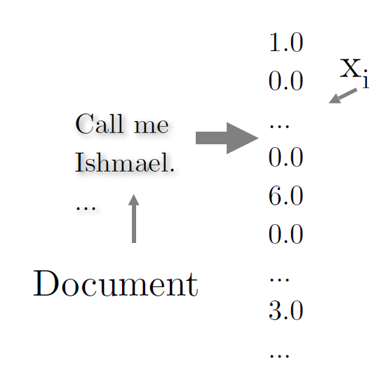
Interpretation – Mallet – Data representation contd…
Transform text documents / data/ Intances to vectors x1, x2,…
Elements of vector are called feature values

Slide 93
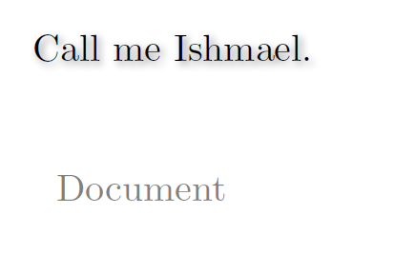
Interpretation – Mallet – Data representation contd…
Documents to Vectors

Slide 94
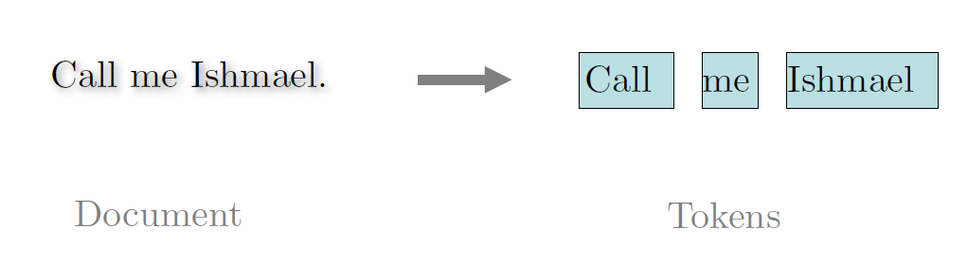
Interpretation – Mallet – Data representation contd…
Documents to Vectors

Slide 95
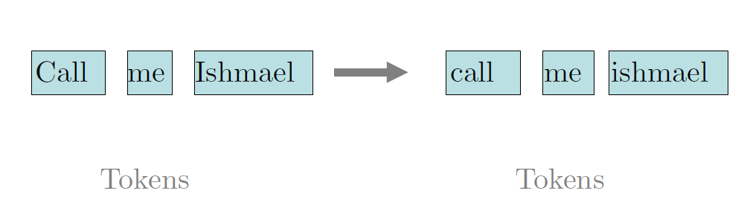
Interpretation – Mallet – Data representation contd…
Documents to Vectors

Slide 96
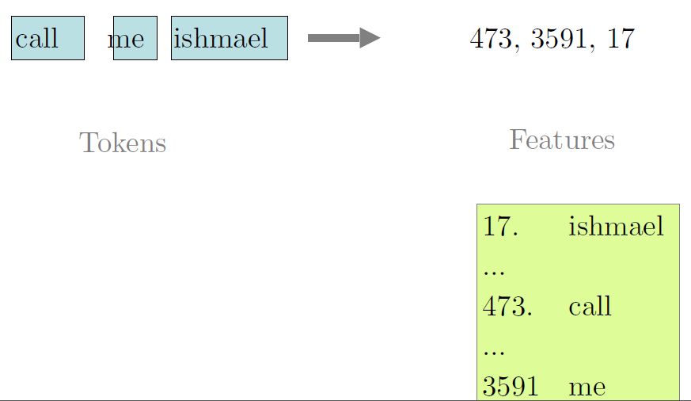
Interpretation – Mallet – Data representation contd…
Documents to Vectors

Slide 97
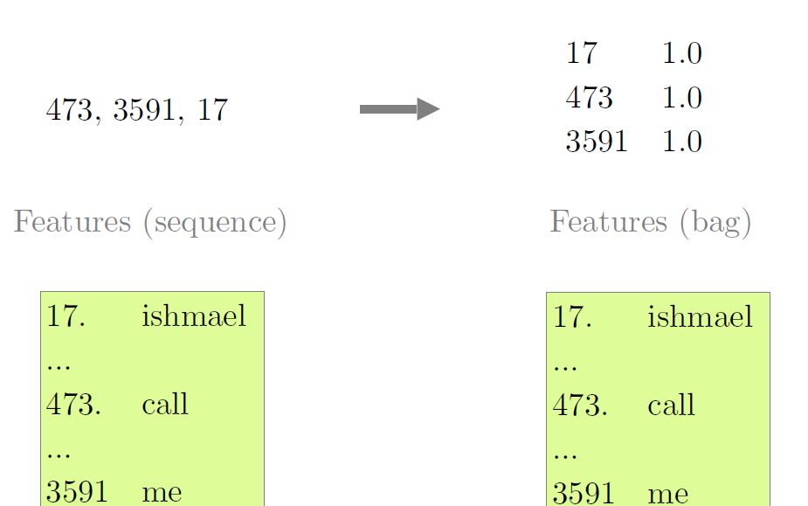
Interpretation – Mallet – Data representation contd…
Documents to Vectors

Slide 98
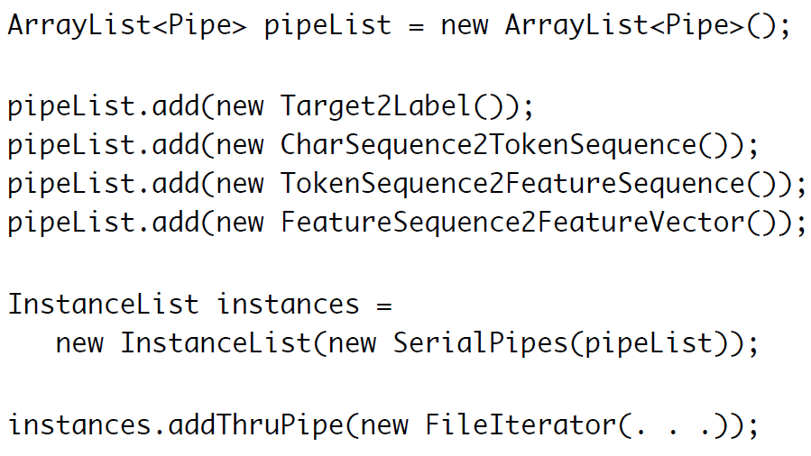
Interpretation – Mallet – Data representation contd…
Pipes to convert data to FeatureVectors
Each instance is passed through a series of pipes to represent the data in FeatureVectors

Slide 99
Interpretation – Mallet – Naïve Bayes Classification
Training:
ClassifierTrainer trainer = new NaiveBayesTrainer();
Classifier classifier = trainer.train(instances);
Testing:
Labeling labeling = classifier.classify(instance);
Label l = labeling.getBestLabel();
System.out.print(instance + “\t”);
System.out.println(l);

Slide 100
NLP Concepts – Level 2
Objective:
Introduction to NLP and hands-on exercises for text mining, information extraction
Duration:
8 hours workshop (4+4, 2 Days)
Learning Outcomes:
Introduction to NLP, major tasks and applications
Typical NLP pipeline and technology stack for Java, Python
Hands-on exercises on text clustering, classification and information extraction using
Java : Mallet, UIMA
Python : scikit-learn, NLTK
Target Audience:
Technical leads / Architects
Senior Developers
Software Required:
Anaconda 4+
Python 2.7, 3.5
Spyder / IDLE python editors
Eclipse + UIMA Plugin
Maven
NLTK
UIMA, Cleartk

Slide 101
NLP Concepts – Level 2 (cont..)
Topics Covered: Day 1 (4 hours)
Text Mining (90 Minutes)
Introduction to text processing, analytics and mining
Text normalization, feature extraction, BOW, Similarity
Clustering and classification
Hands-on Session (150 Minutes)
Text pre-processing, BOW
K-Means clustering
Naïve Bayes classification
Prerequisites:
Java / Python
Regex
Machine Learning
Evaluation metrics (Precision, Recall, ROC)
Topics Covered: Day 2 (4 hours)
Information Extraction (90 Minutes)
Typical NLP pipeline
Default entity extraction models
Custom entity extraction using Regex, POS, Dependency Relations
Hands-on Session (150 Minutes)
Setup
Default, Regex entity extraction
Custom entity extraction exercise
Prerequisites:
Java / Python
Regex
Machine Learning
Evaluation metrics (Precision, Recall, ROC)

